Slide 1
Capstone Design Proposal Presentation

Slide 2
Hello!
We are “LAJI”
-Jisu An
-Hyunjae Lee
-Jinwoo Jeon

Slide 3
Meet the Team
1
ㅇ
AN JISU
LEE HYUNJAE
JEON JINWOO
Jane Doe
Jane Doe
Jane Doe
BACKEND DEVELOPER
System link developer
FRONTEND DEVELOPER
Web crawling, Database, Server
Toss Api, Server, Interaction
QR code scanning, Pos machine UI, User UI
ajs7270@gmail.com
leehj8687@email.com
zinuzian@gmail.com
Notes:
© Copyright Showeet.com – Creative & Free PowerPoint Templates

Slide 4


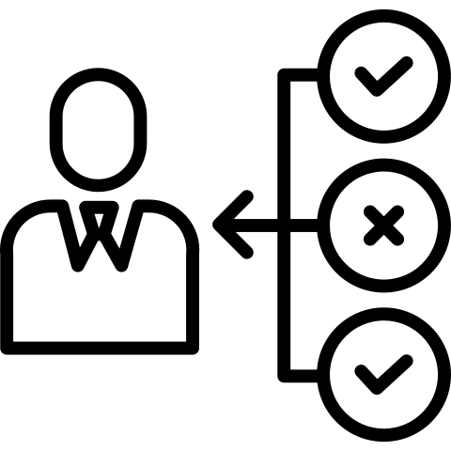


Introductions
Very convenient and interactive ordering process
Scalable and practical solution for both side (consumers and sellers)

Slide 5
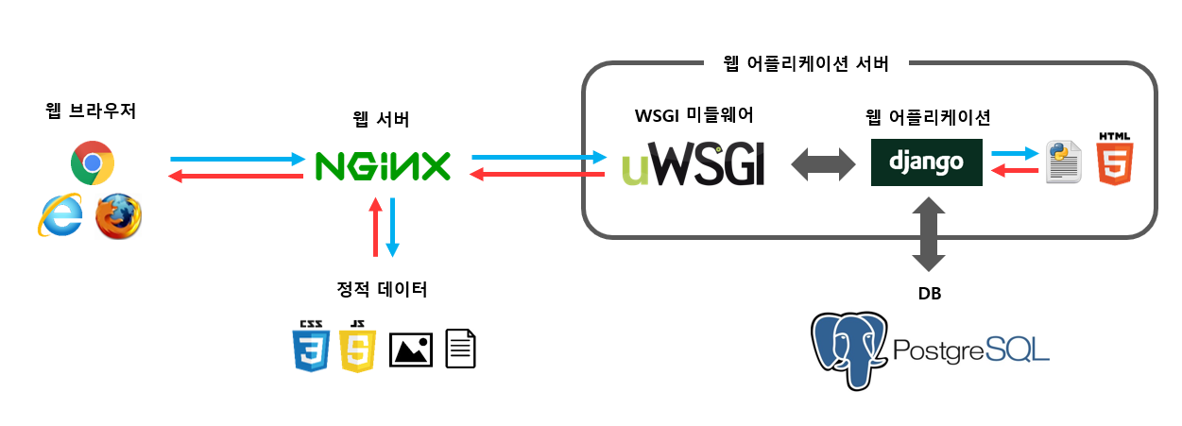
Introductions

Slide 6
Motivations
Cafés and restaurants have tables in each store and provide consumers with food and drinks.
If the number of a group of consumers is large, the store that only has limited staff to work at the same time might get the wrong order information, and for that group, it can be cumbersome to pay individually.
So, we intend to provide more practical and convenient integration.

Slide 7
Goals
All stores can have a common payment process
Prevent order errors in advance and minimize the inconvenience of payment.
From the perspective of sellers,
various information can be analyzed
through real-time table status

Slide 8
Development and Implementation contents
QR code has information to get access of each store.
Groups of people get access to the web by scanning QR code
One of them (called host) can create a party to order and others can get access to the party. Also, sellers can check parties in real-time
Once all member decide their menu, the host decide menu to share.
After deciding all menu, other members will send allocated cost to the host by Toss
Once all other members finish sending the cost, the website let the host and the Pos machine in the store know the ordering information.
The host can pay for it.

Slide 9
Project Schedules
Phase 3
2, Apr – 22, Apr
4 wks
Phase 2
26, Mar – 1, Apr
Phase 1
2 wks
19, Mar – 25, Mar
1 wk
Planning
4, Mar – 18, Mar
Crawling menu and Creating database
Menu selecting and Implementing ordering byToss Api
Midterm
Today
Demo
Week 1
2
3
4
5
6
7
8
9
Creating QR code and Implementing party system

Slide 10
Project Schedules
Phase 5
14 , Mar – 17, Jun
5wks
Phase 4
29, Apr – 13, May
2 wks
Final Demo
Final Report
Final term
9
10
11
12
13
14
15
16
Implementing Pos screen view and ordering system
Implementing Away & Leave

